Slide 1
Lab 2 Content
Master the connection between 8086 and 8255
I/O Address decoding
Master the control word of 8255
Use the 8255 in mode 0
As the input to read from 8 switches
As the output to turn on/off 7-segment LEDs
Master the memory address mapping
How to assign addresses to a memory chip
Understand the concept of even/odd address, high/low byte of data bus, and even/odd banks

Slide 3
For the 8255
Determine the port number according to the circuits
Determine the control word given the requirement of each port (A/B/C) in 8255
As the input to read from 8 switches
As the output to turn on/off 7-segment LEDs

Slide 4
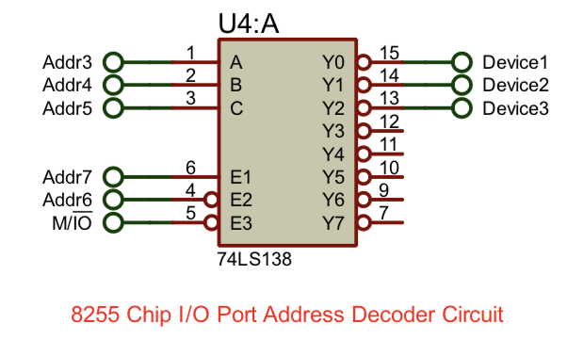
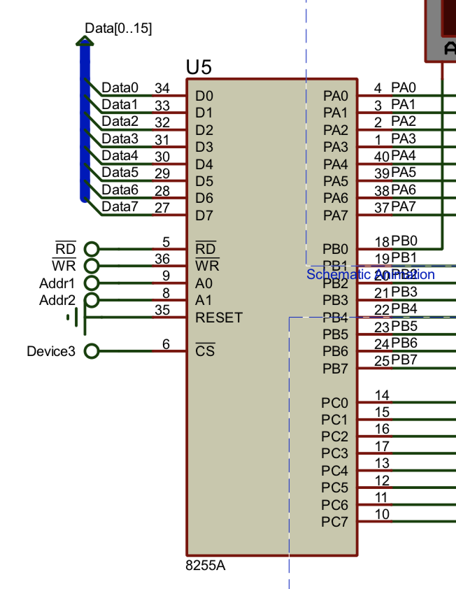
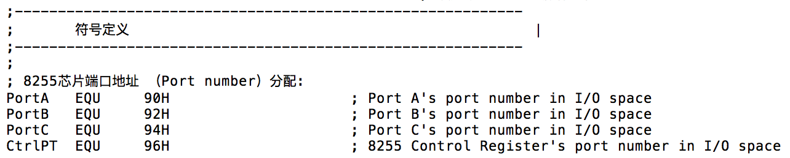
1) Determine the port number
Quiz：how to derive those port numbers?

Slide 5
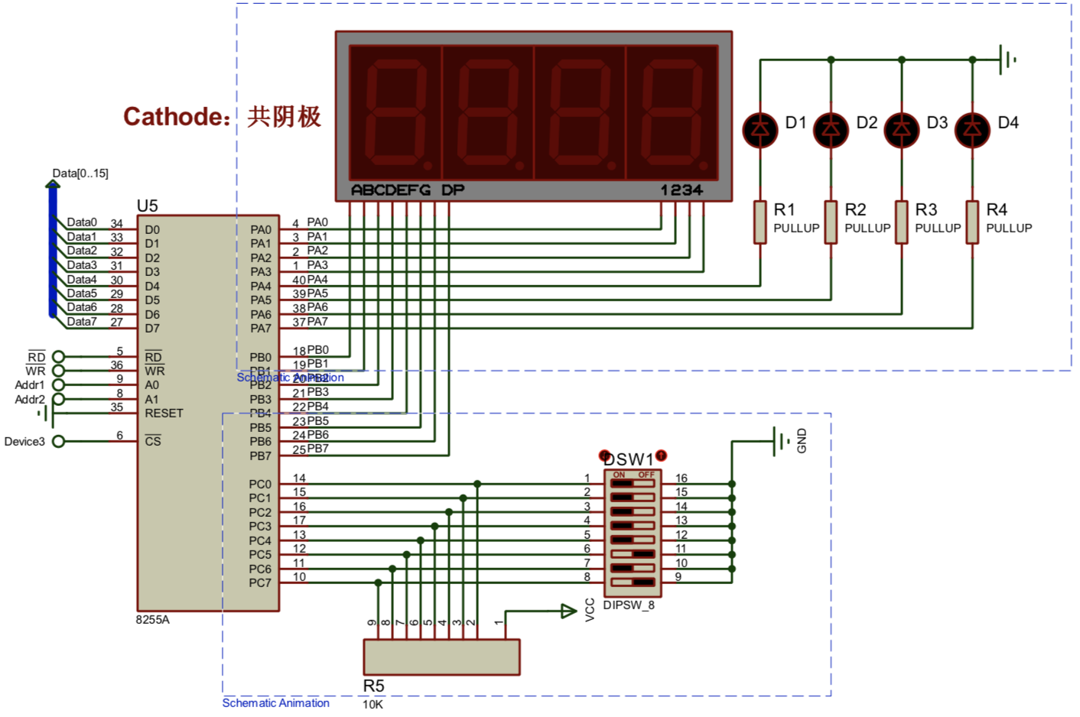
2) Determine the control word
Quiz: what is the port A/B/C used for?

Slide 6
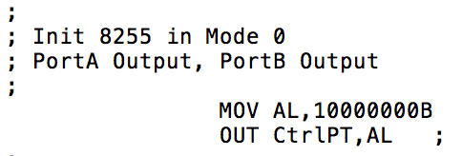
2) Determine the control word
Quiz: the example code configures A/B/C port as output; do we need to modify this?

Slide 7
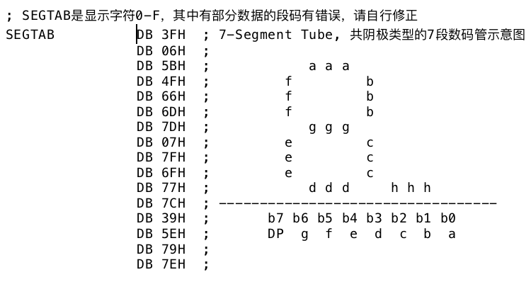
How to drive the 7-segment LEDs
Quiz: what’s the purpose of the above table? Is there any mistakes in it?

Slide 8
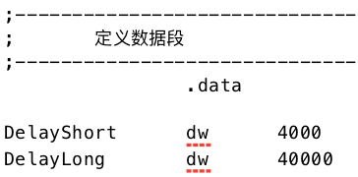
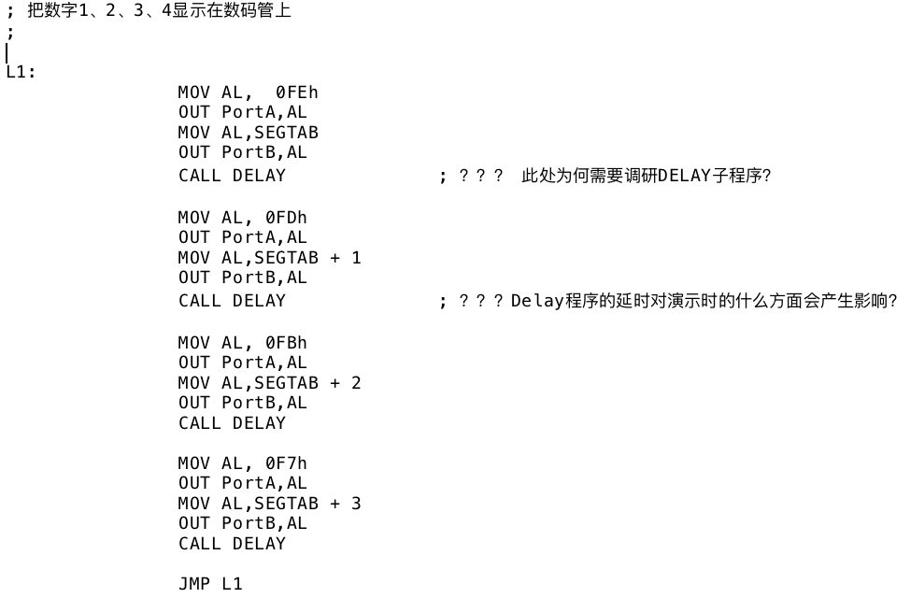
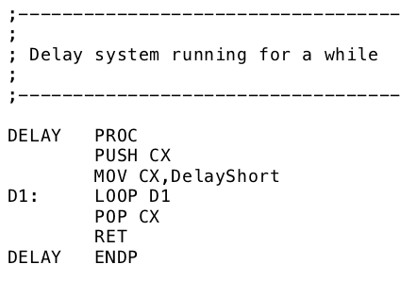
How to drive the 7-segment LEDs
Quiz1: what would happen if we comment the “CALL DELAY” instruction in the code?
Quiz2: what would happen if we change the value of DelayShort variable?

Slide 9
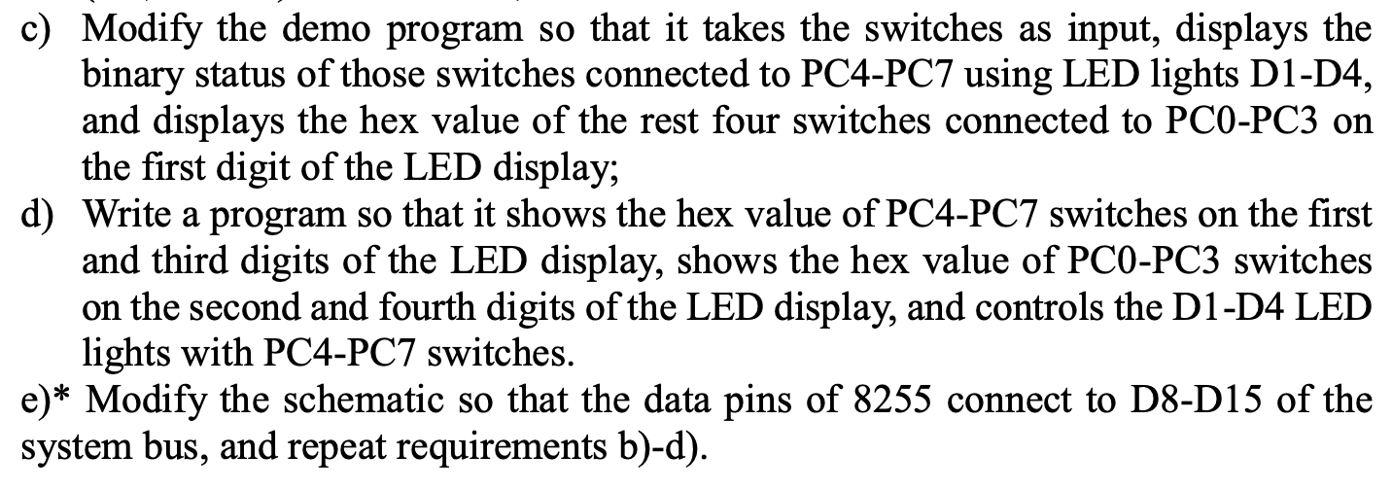
Programming Requirement
1) 8255 part

Slide 10
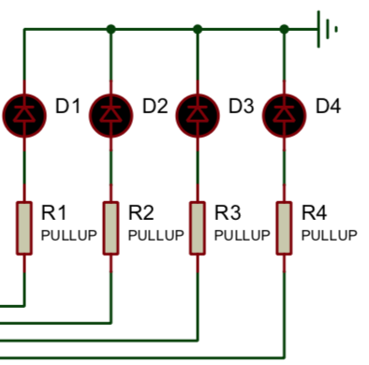
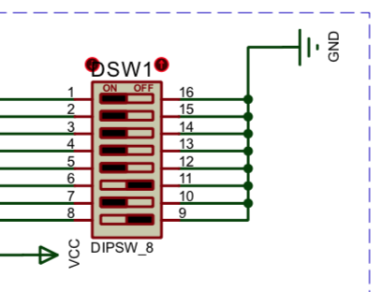
Programming Requirement
1) 8255 part
Read the switch status
Turn on/off 7 segment LEDs correspondingly
Turn on/off the four colorful LEDs

Slide 11
Programming Requirement
2) memory module part
How to determine the memory range for each chip
How to decide even/odd banks
How to write to the given address range

Slide 12
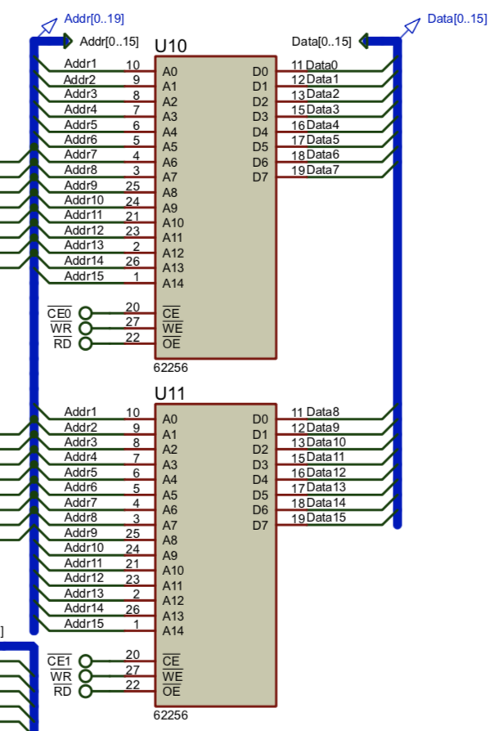
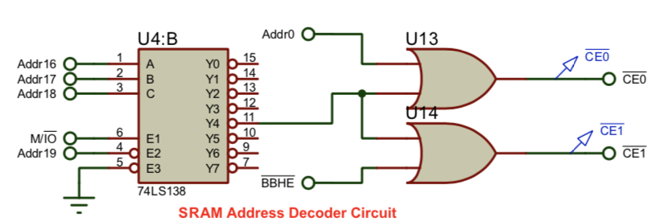

Memory Module Design
Quiz: how to decide the memory address range of U10 and U11? How to decide the segment address for data segment?

Slide 13
Quiz：
What is the address in the U10？
【the even or odd address in xxxxH-xxxxH (64KB) 】
What about U11?

Slide 14
The Error in the Example Code
MOV BYTE PTR [BX],0FFH
MOV [BX],0FFH
Quiz: if we want to write a byte to the address, which instruction is correct and why?
How does the assembler know the size of memory access?

Slide 15
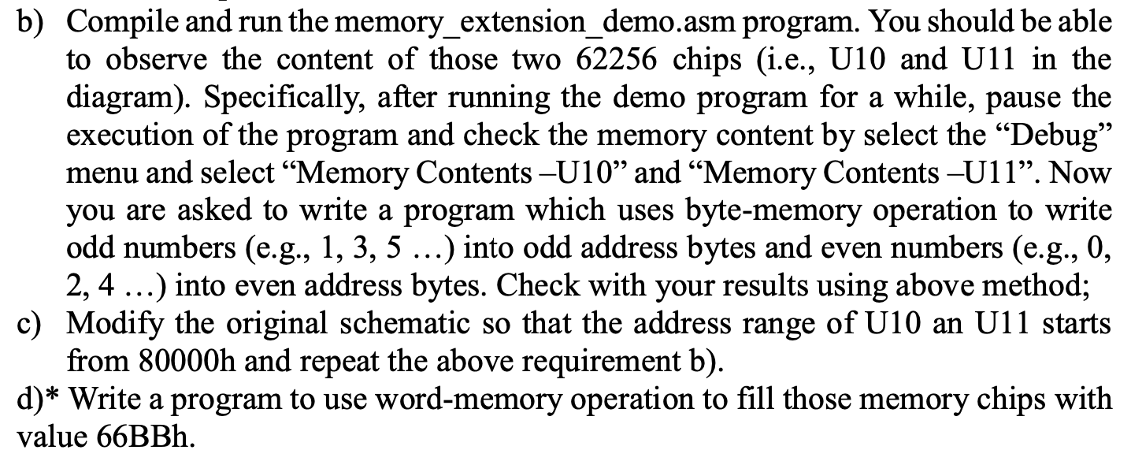
Programming Requirement
Simple loop that we have done before!

